Slide 1
FlipPhone Software Design
https://github.com/kjjl/flip-phone

Slide 2
Background
FlipPhone Control Software (FCS) is loaded onto FlipPhone device to:
Detect fall
Determine fall parameters
Angular orientations
Angular velocities
Height from ground
Predict time until impact
Predict angular orientation at impact
Determine reaction wheel (RW) rotation ramp to control impact angular orientation
Run RW
Detect impact

Slide 3
State Machine
Off
Device switched “On”
Boot Up
Initialization
Standby
Fall detected
Initial Distance Acquisition
Error
Engine Shutdown
Not enough data
Computation time exceeded
Other errors
Timer
Impact Detected
Or Timer
Impact Forecaster + Recovery Calculator
Engine Start
Timer
Notes:
Time check only after Recovery Calculator

Slide 4
Software Requirements Mapping
Requirement | Standby | Distance Acquisition | Impact Forecaster, Recovery Calculator | Engine Controller | Impact Detector
(M) time | X | X | X | X | X
(M) acceleration | X |  |  | X** | X
(M) orientation | X | X |  |  | X
(M) angular vel. | X |  |  |  | X
(M) distance |  | X*
(B) dist. table |  | X*
(R) dist. table |  | X | X
(E) impact time |  |  | X
(E) impact angle |  |  | X
(C) RW params |  |  | X
RW on |  |  |  | X
RW off |  |  |  | X | X
Data logger | X | X | X | X | X
(M) – Measure, (B) – Build, (R) – Read, (E) – Estimate, (C) – Calculate, * - Threaded, ** - Unsure

Slide 5
Standby
Continuously read:
Time
Acceleration
Orientation
Angular velocity
When relative 0 G is detected, save to a variable the latest:
Time
Acceleration
Orientation
Angular Velocity
When relative 0 G is detected, move to Initial Distance Acquisition state

Slide 6
Time Expired State
Return to Standby state

Slide 7
Initial Distance Acquisition
Using time, orientation, and angular velocity at 0 G, generate a table of time and predicted orientation.
Continuously read:
Time
When time matches time at which predicted orientation is facing ground, ping distance and save to an array of tuples the latest:
Time
Distance
If a minimum number of distances are recorded before a timeout, move to Impact Forecaster state. Otherwise move to Time Expired state

Slide 8
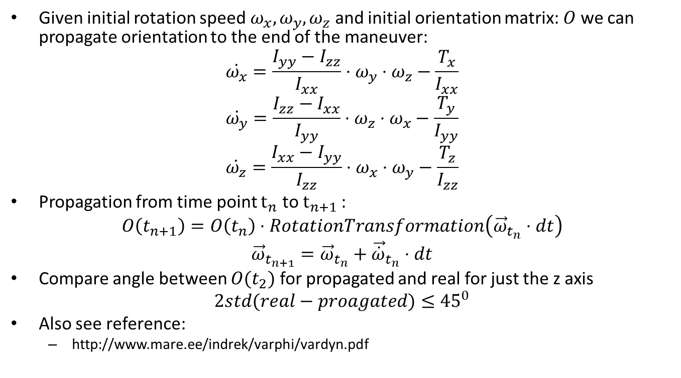
Generate Time-Predicted Orientation Table
Given initial rotation speed $ω_{x},ω_{y},ω_{z}$ and initial orientation matrix: $O$ we can propagate orientation to the end of the maneuver:
$$\dot{ω_{x}}=\frac{I_{yy}−I_{zz}}{I_{xx}}⋅ω_{y}⋅ω_{z}−\frac{T_{x}}{I_{xx}}$$
$$\dot{ω_{y}}=\frac{I_{zz}−I_{xx}}{I_{yy}}⋅ω_{z}⋅ω_{x}−\frac{T_{y}}{I_{yy}}$$
$$\dot{ω_{z}}=\frac{I_{xx}−I_{yy}}{I_{zz}}⋅ω_{x}⋅ω_{y}−\frac{T_{z}}{I_{zz}}$$
Propagation from time point $t_{n}$ to $t_{n+1 }$:
$$O\left(t_{n+1}\right)=O\left(t_{n}\right)⋅RotationTransformation\left({\vec{ω}}_{t_{n}}⋅dt\right)$$
$${\vec{ω}}_{t_{n+1}}={\vec{ω}}_{t_{n}}+{\vec{\dot{ω}}}_{t_{n}}⋅dt$$
Compare angle between $O(t_{2})$ for propagated and real for just the z axis
$$2std(real−proagated)≤{45}^{0}$$
Also see reference:
http://www.mare.ee/indrek/varphi/vardyn.pdf

Slide 9
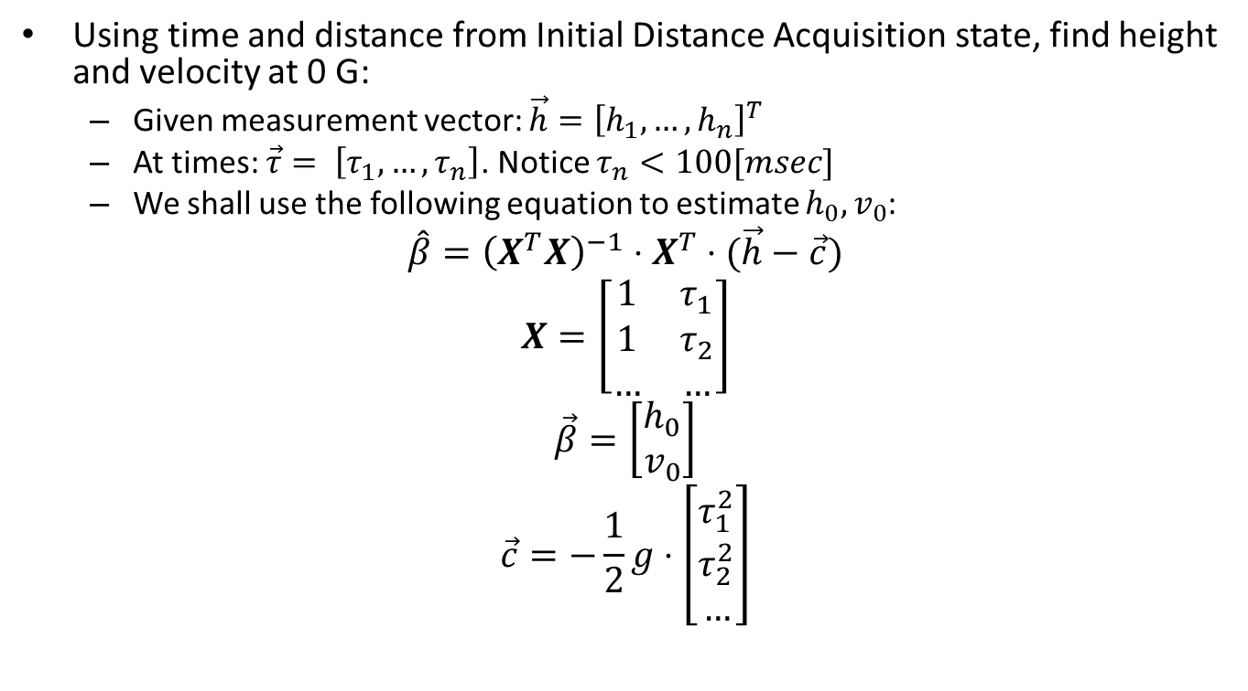
Impact Forecaster
Using time and distance from Initial Distance Acquisition state, find height and velocity at 0 G:
Given measurement vector: $\vec{h}={\left[h_{1},…,h_{n}\right]}^{T}$
At times: $\vec{τ}= \left[τ_{1},…,τ_{n}\right]$. Notice $τ_{n}<100[msec]$
We shall use the following equation to estimate $h_{0},v_{0}$:
$$\hat{β}={\left(X^{T}X\right)}^{−1}⋅X^{T}⋅(\vec{h}−\vec{c})$$
$$X=\left[\begin{matrix}1 & τ_{1} \\ 1 & τ_{2} \\ … & …\end{matrix}\right]$$
$$\vec{β}=\left[\begin{matrix}h_{0} \\ v_{0}\end{matrix}\right]$$
$$\vec{c}=−\frac{1}{2}g⋅\left[\begin{matrix}τ_{1}^{2} \\ τ_{2}^{2} \\ …\end{matrix}\right]$$

Slide 10
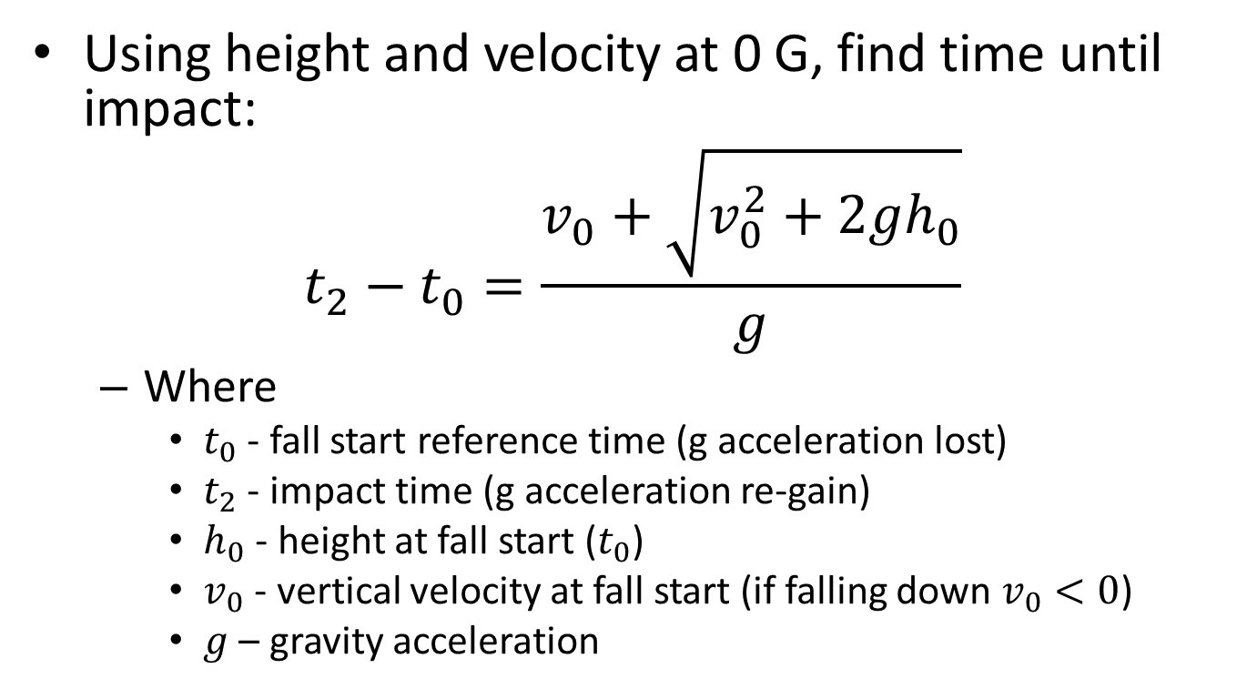
Impact Forecaster
Using height and velocity at 0 G, find time until impact:
$$t_{2}−t_{0}=\frac{v_{0}+\sqrt{v_{0}^{2}+2gh_{0}}}{g}$$
Where
$t_{0}$ - fall start reference time (g acceleration lost)
$t_{2}$ - impact time (g acceleration re-gain)
$h_{0}$ - height at fall start ($t_{0}$)
$v_{0}$ - vertical velocity at fall start (if falling down $v_{0}<0$)
$g$ – gravity acceleration

Slide 11
Impact Forecaster
Using time until impact and time-predicted orientation table, identify orientation at impact.
If impact time and impact orientation have been determined and timeout has not been exceeded, move to Recovery Calculator state. Otherwise, move to Time Expired state.

Slide 12
Recovery Calculator
Given initial orientation, initial angular velocity, time until impact, and predicted impact angle, calculate RW ramp to change impact orientation to be within safe zone.
If timeout has not been reached, move to Engine Controller state. If timeout has exceeded, move to Time Expired state.

Slide 13
Calculate RW Ramp

Slide 14
Engine Controller
Send RW ramp instructions to engine.
If timeout has exceeded, move to Time Expired state.

